Slide 1
TAI Query reporter Users guide version 1.0.0.1
February 9, 2011

Slide 2
Introduction
TAI Query Tool provides users with ad hoc ability to generate customized reports and analytics to monitor and improve their daily operations.
The tool’s graphical capability enables users to visualize the results.
Query tool’s functionality resembles that of Microsoft SQL Query Analyzer where a user has the flexibility to manipulate data at the lowest level.

Slide 3
General
The Query tool enables users, familiar with data elements of a database and knowledge of where to find certain information, to explore the depth and wealth of data.
Data dictionary document, if available, is a good reference material describing data elements in tables and databases.
This version of the tool requires .NET 4 Framework to be installed on the machine on which the tool is executed/run from.

Slide 4
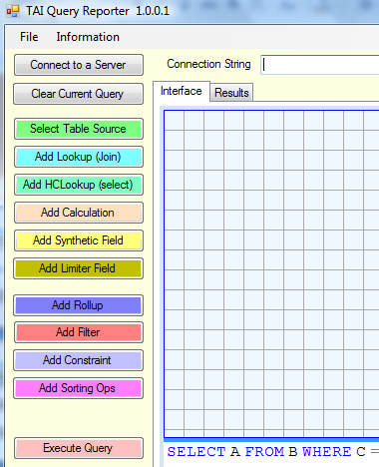
Key Functionality
The following lists key functionality of the tool as depicted by the buttons to the right in a partial screen capture:

Slide 5
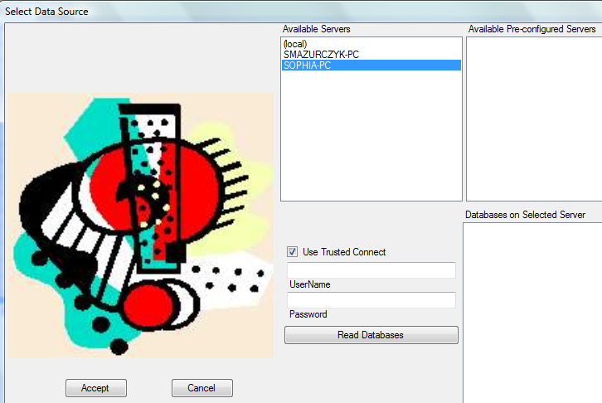

Connect to a Server
The first step is to find a database server. Click on the
button.
The tool will automatically search and display a list of available database servers that are accessible to the tool.
Users will need a SQL login to the server to which they’ll be connecting.

Slide 6
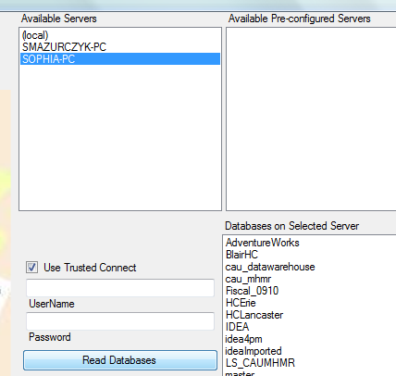
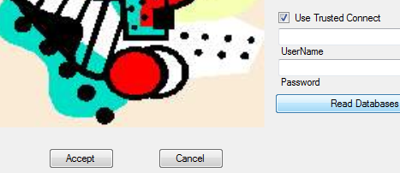
Select Server & dB
Click on one of the servers that appear in the Available Servers box.
Then click on the Read Databases button. A list of available databases will be displayed in the Databases on Selected Server box.
Click on the database
you would like to work
with – i.e. BlairHC.
Then click on the Accept
button

Slide 7
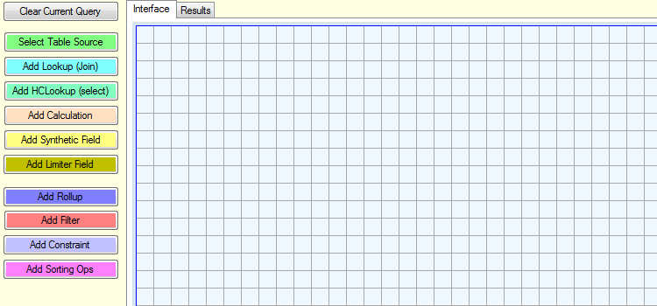
Clear Current Query
Clicking on the Clear Current Query button will erase the work area in preparation for a new query.

Slide 8
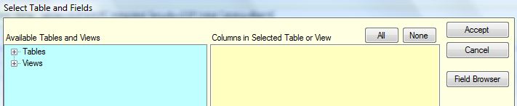
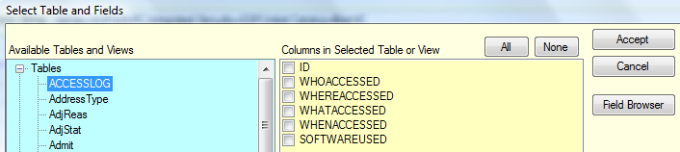
Select Table Source
Before you can start creating queries, you will need to select the tables, their fields/data elements, etc.
To obtain a list of tables, expand them by clicking on the plus sign to the left of the Tables.
Then click on the actual table – i.e. ACCESSLOG and the list of its fields will be displayed in the area to the right. Select the individual fields by clicking to the left of each and then press Accept button.

Slide 9

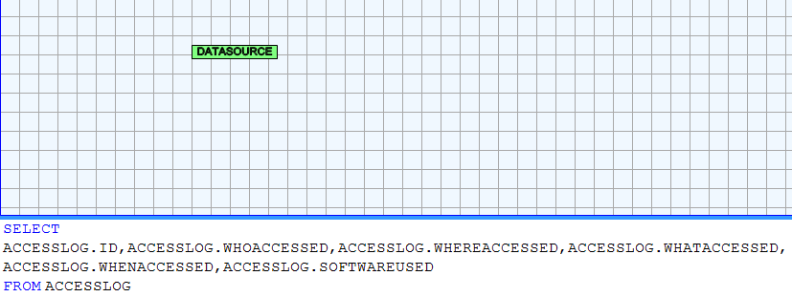
Query Display
Clicking on the Field Browser button will display table data.
The basic query was started when you accepted the fields. This is illustrated by the DATASOURCE image in the work area. Below the work space is the actual SQL query that is created for you.
If you mouse over the image, you’ll see the details such as the table and fields selected.

Slide 10
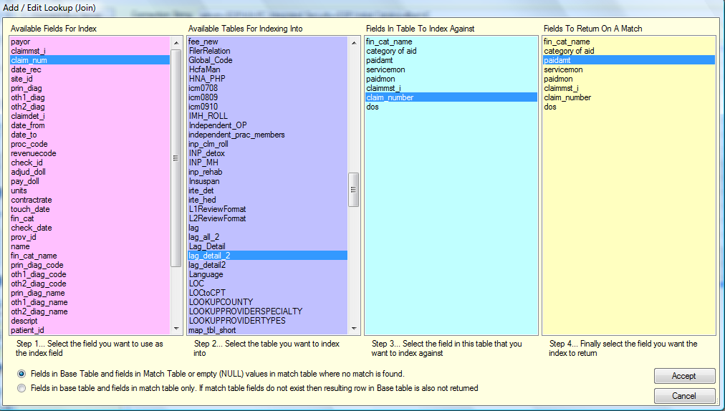
Add Lookup (Join)
This functionality allows you to collect data from two different tables where both tables have a field that is common. This field will link the two tables.
For example, if you need to pull data that spans among multiple tables (i.e. partly in Claims_all and partly in Lag_detail2), a field that is common to both in this case is “claim_num” and “claim_number” in the Lag_detail2 table.

Slide 11
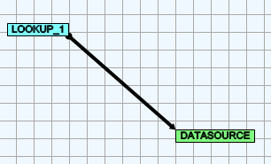
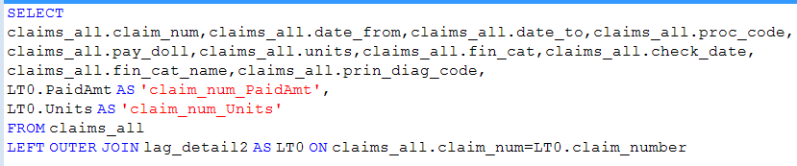
Lookup detail
This will result in a Lookup_1 image in your work space
It will also add to the query on the bottom, below the workspace.

Slide 12
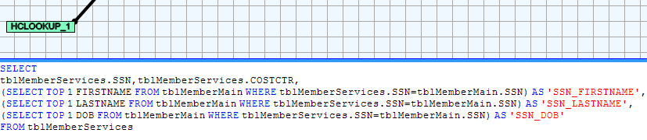
Add HCLookup (Select)
This function is similar to the other Lookup with the exception that is does a “ Select TOP 1” subquery rather than a Join. The purpose is to ensure that data element from only one record is used for joining. This may be useful in an environment with duplicate records – such as duplicate members

Slide 13
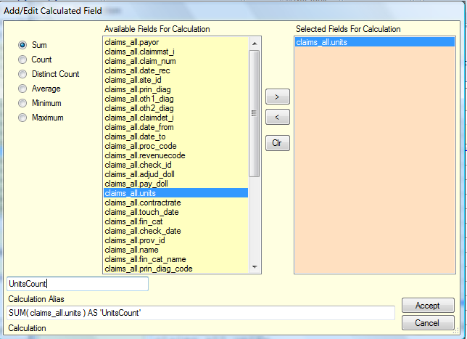
Add Calculation
This function allows users to run a total on a specific data field.
If you notice, the actual query is displayed in the Calculation text box.
You can name the resulting displayed field to something more meaningful in the Calculation Alias text box.
Clicking Accept button
will add this function
into the query in your
work space and it
appears as SUM

Slide 14
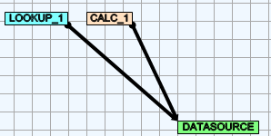
Calculation – SQL SUM
Image Calc is displayed in the work area.
Sum line is added into the query.

Slide 15
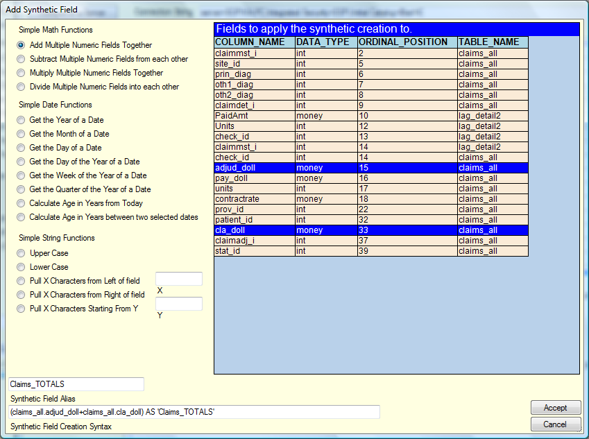
Add Synthetic Field
This function serves the purpose of doing additional calculations or manipulation of data fields. For example if you want to add two existing fields to create a new field on the report.

Slide 16
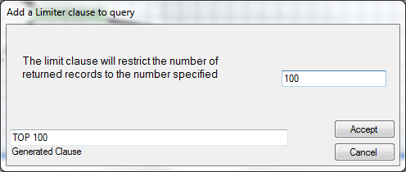
Add Delimiter Field
This function gives you the control over how many records will be returned from the query. For example, this may be useful if you’re interested in the top 100 members only. This will translate to “SELECT TOP 100” in the query.

Slide 17

Add Rollup
Rollup function lets you group or organize your records that will be displayed by selected fields you chose to be in the results set. Rollup is performed on rows of informational record set with same values.
A Rollup image will be added to graphical portion of the work area
SQL “GROUP BY” listing selected fields will be added to the query

Slide 18
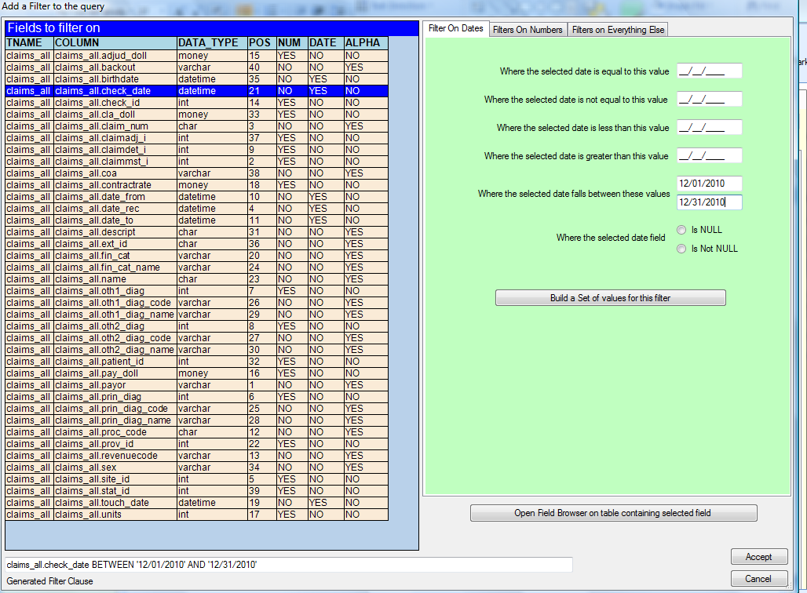
Add Filter
Filtering allows you to narrow down your results set. For example, you may only be interested in claims that were paid in the month of December 2010.
You can also filter on number fields or fields containing certain values.
Filters translate to SQL “WHERE” clause.

Slide 19
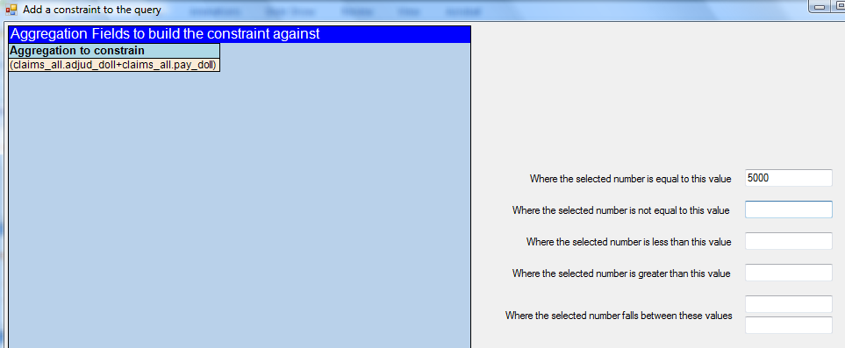
Add Constraint
This function works on the field(s) you’ve created with the Add Synthetic Field button.
It lets you sets limits or constraints on the values of the created field.
For example, if you’re interested in claims whose payment is $5000

Slide 20
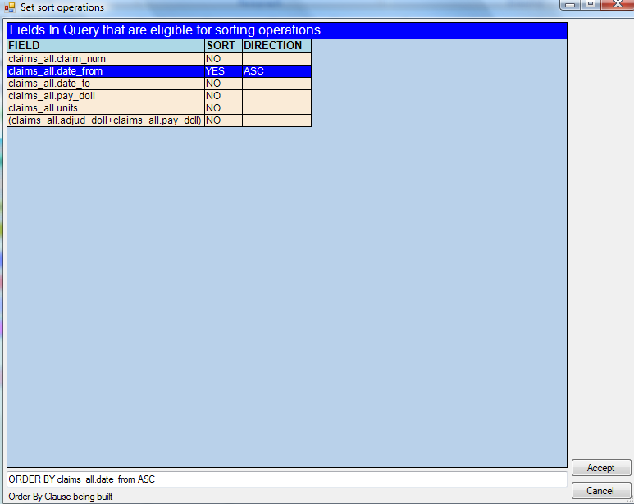
Add Sorting Ops
Sorting helps you to force your results set to be arranged or ordered by certain fields and also in either ascending or descending.
For example, you may want to display the results by member’s last name in the ascending order or claims by service date.
This function translates to SQL “ORDER BY”.

Slide 21
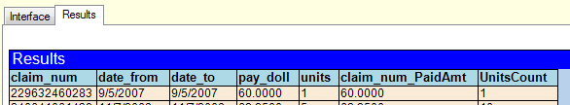
Execute Query
This button is self explanatory – clicking it will run the query that was created.
The outcome/results will be displayed in the area under the Results tab.

Slide 22
Saving queries
Once you have created a query that works (gives you what you need), you can save it and run it as required with possibly changing some filters such as check dates, etc.
To Save a query, click on File then select a folder that may be designated for queries.
You can then File/Open at some later date and just Execute the saved query to produce the desired report.

